Slide 1


Executive Summary
Sanjli Gidwaney
sanjli@designforchange.us

Slide 2
What is Design for Change?
DESIGN FOR CHANGE is the largest global movement designed to give young people an opportunity to express their own ideas for a better world and to put them into action.
Design for Change (DFC) reaches 35 countries and over 300,000 schools, inspiring thousands of children, teachers, parents, and communities around the world.
DFC USA, our vision is to integrate the DFC framework into service-learning curriculums across the country. We are working to empower all students with the confidence, compassion, and agency to find solutions to their most pressing community challenges.

Slide 3
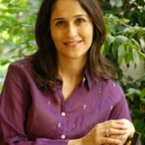


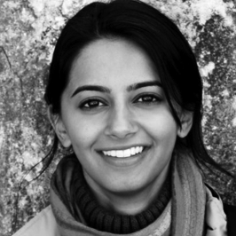
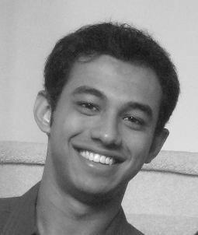




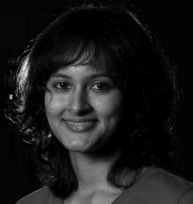

Who Are We?
Kiran Bir Sethi – Founder
- Renowned educator in India
- Principal at the Riverside School in Ahmedabad
- Recognized by the Rockefeller Foundation as a Young Innovator of the Year (2012) - Ashoka Fellow
- TED India Speaker 2009
The Design for Change USA Team
- Educators
- Designers - Technologists

Slide 4
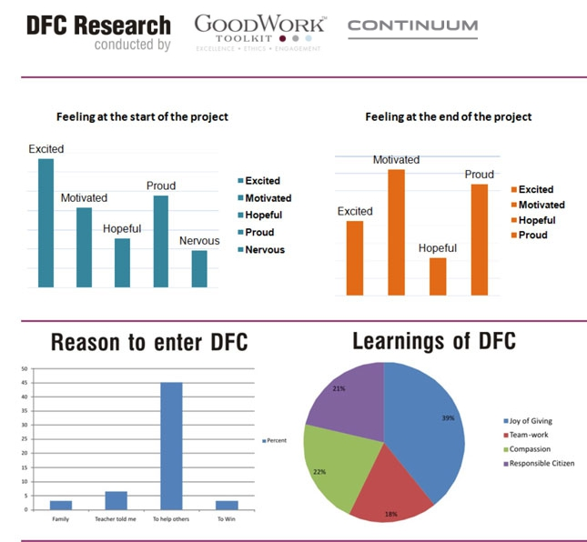
Proven Impact

Slide 5
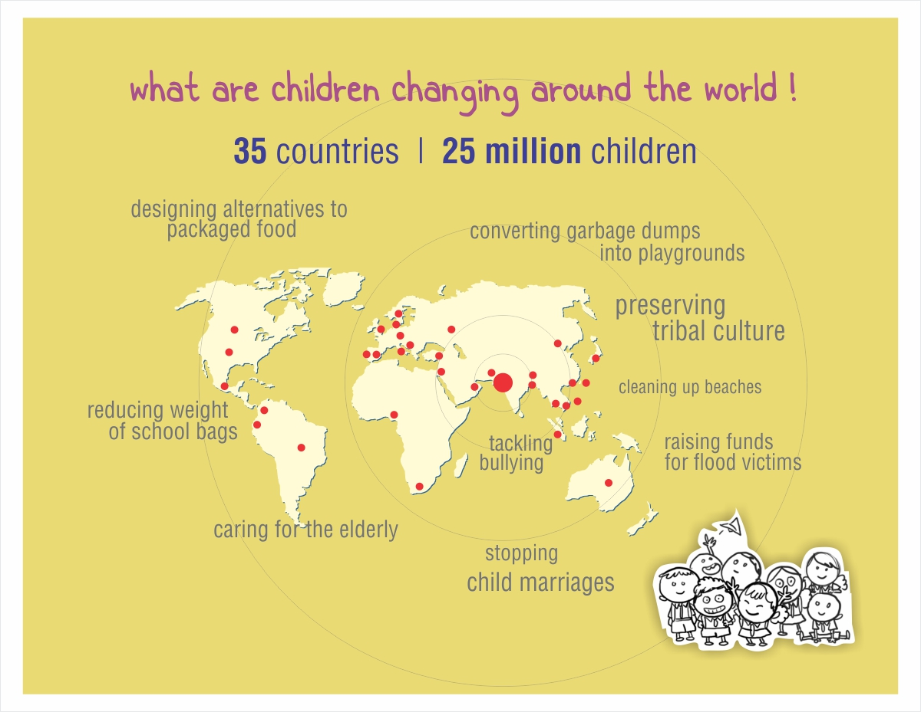
Notes:
Design for change has worked with students and students in over 35 countries. All the projects are student-led and address issues in the student’s local communities.

Slide 6




Experimental Elementary School, Tapei, Taiwan
Antono Park Primary
School, Australia
Redona, Brazil
Project Transformation
Your Existence is not only sound to me
4RV
Notes:
Examples of how children used the design stages of Feel, Imagine, Do and Share to make a change.

Slide 7
Children use a simple process of
FEEL
( anything that bothers them)
IMAGINE
( brainstorm ways to make it better )
DO
( implement the act of change )
SHARE
( send the stories to inspire others )

Slide 8

“Think From Your Heart”
SENSITISE: Ask children to walk around their school / community and locate problems / situations that bother them.
IDENTIFY: Ask them to identify the people affected by the problem and THOSE who are part of the problem.
ENGAGE: Ask the children to speak with the people who are affected / part of the problem and ask them WHY the situation is the way it is.

Slide 9

Brainstorm Ideas
Get the children to look at ways in which the situation can be changed for the better.
All ideas are valuable; think bold, think creative; go for volume.
Criteria for solutions:
Potential to be replicated EASILY.
Potential to impact MAXIMUM number of people.
Potential for LONG LASTING change.
Potential for QUICK impact.

Slide 10

“Yes, I Can”
Get children to work together to make the idea a reality.
How many people will be needed?
What resources will be required?
What is the budget, how will they get the money?
How much time will it take?

Slide 11

“I Can! And now you can too”
Share the story to inspire others with the I CAN spirit
Invite the community.
Invite parents.
Invite the Press to cover the story!
Send your children with the story to other schools and inspire them to ‘Be the Change’ as well!

Slide 12









In The United States
Our Supporters
Our School Partners

